Slide 1
Endocrine Glands

Slide 2
What are we doing today?
Synthetic hormones may be developed to control or treat endocrine dysfunction, including hypothyroidism and hyperthyroidism, to improve the quality of life for individuals (SHE)

Slide 3
Keywords
Diabetes:
Insulin:
Thyroxine and tri-iodothyronine:
Hyperthyroidism:
Hypothyroidism:
Human growth hormone (hGH):

Slide 4
Homeostasis and hormonal disruptions
Homeostasis is the maintenance of a constant internal environment so that cells can function at their optimal level.
Diabetes will see a disruption in this functioning due to increased glucose in ones blood.
There are other disruptions to homeostasis, though there are treatments to assist in trying to maintain regular homeostasis.

Slide 5
Diabetes
Also known as diabetes mellitus
Results in abnormally high blood glucose, known as hyperglycaemia
During homeostasis, there is a balance between the hormones insulin and glucagon
A diabetic will suffer from a lack of insulin production or their cells will be resistant to insulin
Insulin stimulates the uptake of glucose from blood by cells. It also allows the conversion of glucose into glycogen by the liver and muscle cells
A lack of insulin, or insulin resistance by the cells will see high levels of glucose remain in ones blood and urine

Slide 6
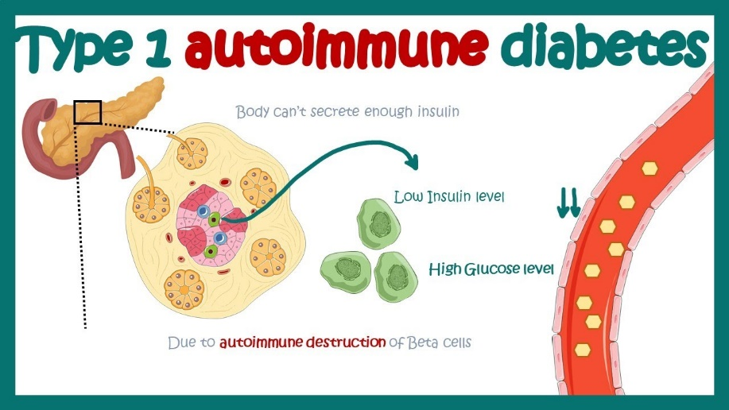
Type 1 Diabetes
Insulin dependent diabetes
Begins in childhood and is often termed juvenile diabetes
Affected individuals have their immune system attack beta cells. These cells produce insulin and attacking them inhibits insulin production
Fortunately, insulin can be administered to these individuals
Insulin must be injected, as consuming it orally will see it break down in the alimentary canal
Regular injections are necessary and can be achieved by administering it manually or via an interval pump
Long term effects include kidney failure, heart attack, stroke, amputation, blindness or nerve damage

Slide 7
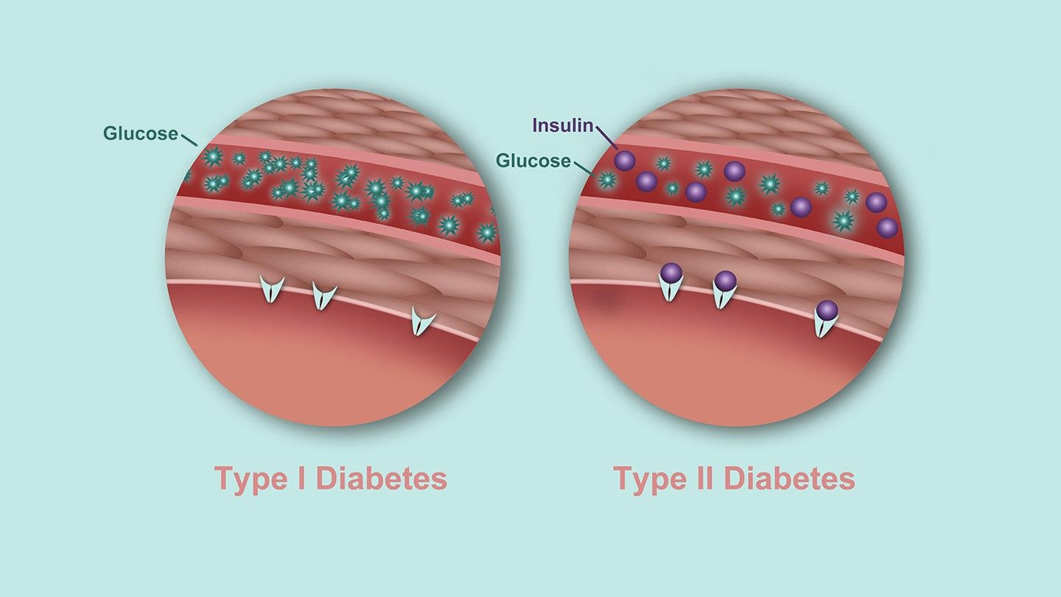
Type 2 Diabetes
Non-insulin dependent, aka adult onset diabetes
Insulin is still produced but cells do not respond to it
Occurs due to lifestyle – a lack of physical activity, obesity, poor diet, high blood, high cholesterol and smoking
Does not display obvious symptoms; estimated that half of type 2 diabetes cases are undiagnosed
As cells do not respond to insulin, they do not uptake glucose
No cure, but early diagnosis enhances management methods
Managing diet, exercise and weight help maintain regular blood glucose levels

Slide 8
Excess and deficiency of thyroid hormones
Can be over or under secretion of thyroid hormones
The thyroid gland is located in the neck and releases thyroxine and tri-iodothyronine
These hormones stimulate carbohydrate, protein and fat metabolism which regulate basal metabolic rate
These reactions also release heat and maintain body temperature, especially important in the homeostasis that occurs in body temperature between winter and summer
Thyroxine release is stimulated by thyroid stimulating hormone (TSH) which is secreted by the anterior lobe of the pituitary, though release of TSH is controlled by the hypothalamus

Slide 9
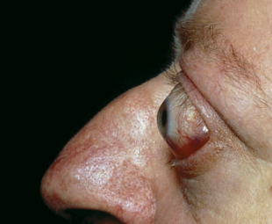
Hyperthyroidism
Hyper = too much / too high
In this case, the thyroid gland produces too much hormone
Grave’s disease is the most common type of hyperthyroidism, caused by an immune response that enlarges the gland
Some genetic link made, though disease is not inherited
Symptoms include increased heart rate, weight loss, increased appetite, fatigue, sweating, anxiety and protruding eyeballs
Treatment includes drugs (iodine blockers) or surgery to remove the gland (partially or entirely)
Radioactive iodine can also be consumed in solution to kill thyroid cells. Other cells in the body will remain unaffected

Slide 10
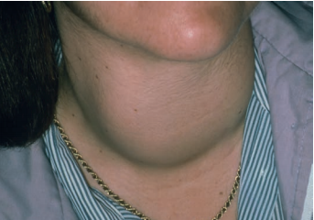
Hypothyroidism
Hypo = too little
More common than hyperthyroidism
6-10% Australian women suffer, and a smaller proportion of men
Can occur due to issues with the thyroid gland, pituitary gland and/or hypothalamus
Symptoms include slowed heart rate, weight gain, fatigue, lacking energy, intolerance to cold, swelling in the face and goitre
Occurs due to a lack of iodine – thyroxine contains four iodine molecules (T4) and tri-iodothyronine contains three (T3). Therefore a lack of iodine impacts hormone production
This lack of production will enlarge the thyroid in its attempt to produce more of these hormones – this is called goitre
To prevent hypothyroidism, iodine in diet is essential and can be found in iodised salt and in many bread products
Treatment includes iodine supplements. This aids management of the condition but it is incurable and tablets must be consumed for the rest of the patients life

Slide 11
Human Growth Hormone (hGH)
hGH is synthesised and secreted by cells in the anterior pituitary
Essential in normal growth and metabolism
Deficiency can result in growth retardation or dwarfism
Children with retarded growth can be treated with hGH injections
In the past, hGH was extracted from the pituitary of deceased individuals, requiring up to 50 glands to retrieve a sufficient amount
It is now genetically engineered from recombinant DNA found in E. coli bacteria. This supply is virtually unlimited and can be used in treating growth issues, enhancing athletic performance and anti-ageing treatments

Slide 12
Contrast of hormones and nervous coordination
Both systems are involved in communication within the body
They do not duplicate roles, instead, they complement and reinforce one another
Nerve and hormone action is contrasted below:
Nerves are far quicker than hormones in their travel (nerves travel along fibres, hormones through blood)
Stimulus ceasing causes a response. This is almost instantaneous in nerves, but can take up to days with hormones
Nerve messages travel along a neuron membrane, whereas hormones travel in blood
Nerve impulses are direct to a specific part of the body, hormones have to travel through various parts of the body until they reach their target
The above points are generalisations for most nerves / hormones, though some hormones can act differently (adrenaline being a rapid travelling hormone)

Slide 13
Similarities between nerves and hormones
Similarities include:
Some substances act as both hormones and neurotransmitters (noradrenaline, antidiuretic hormone and dopamine)
Some hormones are released by neurons into extracellular fluid (oxytocin and adrenaline)
Some hormones and neurotransmitters have the same effect on their target cells (noradrenaline and glucagon both cause the liver to break down glucose)
A comparative table between both transmission systems is to follow on the next slide

Slide 14
